Slide 1




Team Members
Srividya Chekuri
Divya Soma
Sai Venkata Ajay Varma Alluri

Slide 2



Project Topic:
Resume Screener

Slide 3

Statement of project Objectives
Resume Parser aims to speed up screening process of a candidate.
In the recruitment process, it is inefficient, slow, and costly to scan with hundreds of resumes one by one based on the skill-set.
Resume parser automates the screening.
Resume parsing is tricky. There are hundreds of ways of doing it. Our Resume screener aims to speed up screening process of a candidate. Given a bulk of resumes, a Resume Screener outputs the top N candidates for the described role.

Slide 4

Statement of Value
1.Speeding up the recruitment process.
2.Spend more time on the best candidates.
3.Increased automation, reaching best candidates

Slide 5
State of Art
1.Keyword-Based Screening in ATS:
Traditional ATS systems heavily rely on keyword-based screening, where resumes are matched against a predefined set of keywords and phrases relevant to the job description. While this method simplifies the screening process, it may result in a lack of nuance and context understanding.
2.Integration of Advanced Technologies in ATS:
More sophisticated ATS systems are now integrating machine learning (ML) and natural language processing (NLP) techniques. This technological advancement enables a deeper understanding of context and semantics within resumes, facilitating a more nuanced and comprehensive evaluation of candidate profiles.
3.Customization and Personalization Features:
Leading ATS providers recognize the importance of customization and personalization. They offer features that empower organizations to tailor their screening criteria and workflows according to their specific hiring needs. This customization ensures that the ATS aligns seamlessly with an organization's unique requirements, enhancing the effectiveness of the hiring process.

Slide 6
Relevant works
Google for Jobs:
Google has introduced its own job search platform that incorporates AI and machine learning for matching job seekers with job postings, effectively functioning as an ATS.
LinkedIn Talent Solutions:
LinkedIn's suite of recruiting tools includes an ATS that uses AI and NLP to help organizations find and manage candidates more efficiently.

Slide 7
Approach
Text Extraction: Utilize docx2txt and pdfminer.six to extract text content from DOCX and PDF files, respectively. This ensures that the textual information from different resume formats is captured.
NLP Processing with NLTK: Leverage NLTK for NLP tasks such as text preprocessing. This can involve filtering out stopwords, tokenizing the text, and stemming to obtain a clean and standardized representation of the textual content.
Matching to Job Descriptions: Implement NLP capabilities to match extracted resume text with job descriptions. This involves identifying relevant skills, experiences, and qualifications within the resumes and comparing them to the requirements specified in job descriptions.
Overall Functionality: The combination of text extraction tools and NLTK provides a robust foundation for building a resume screener with NLP capabilities. The approach ensures that the system can handle various resume formats, preprocess the text effectively, and perform NLP tasks to match candidates with job requirements.

Slide 8
Approach
Universal Sentence Encoder (USE):
Usage: Developed by Google, USE provides sentence-level embeddings. You can use pre-trained USE models to encode both resumes and job descriptions and measure similarity.

Slide 9
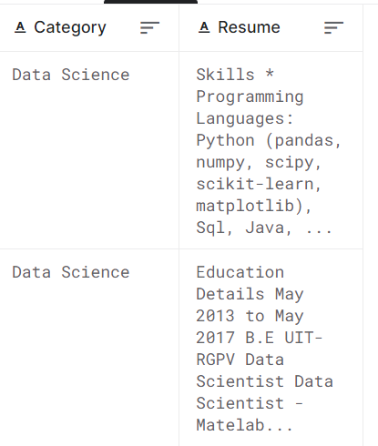
Datasets
Test Dataset
https://www.kaggle.com/datasets/gauravduttakiit/resume-dataset
Training Dataset
https://www.kaggle.com/datasets/snehaanbhawal/resume-dataset

Slide 10
Deliverables
Project report (pdf)
Working project files (ipynb)
Project demo Video
Project PowerPoint presentation

Slide 11
Evaluation Methodology
Skill Matching:
Extracting skills from each resume using the get_skills function. Comparing the extracted skills against the specified required skills in required_skills. Calculating a skill match score based on the number of matching skills.
Education Matching:
Extracting education information from each resume using the get_education function. Comparing the extracted education against the specified required education in required_education. Calculating an education match score based on the number of matching education criteria.

Slide 12
Overall Match Score:
Combining the skill match score and education match score to generate an overall match score. Calculating the overall match score as the sum of the skill match score and education match score.
Top-N Resumes:
Identifying the top-N resumes with the highest overall match scores. Printing information about these top-matching resumes, including the match score and skillset.
This methodology provides a comprehensive assessment of resume suitability for a given job category, considering both skills and education criteria. The top-N resumes are highlighted based on their overall match scores, aiding in efficient candidate selection.

Slide 13



References
https://blog.apilayer.com/build-your-own-resume-parser-using-python-and-nlp/
https://www.smartrecruiters.com/resources/glossary/resume-parsing/
https://github.com/meghnalohani/Resume-Scoring-using-NLP/blob/master/RESUME%20SCORING%20USING%20NLP.pdf
https://www.analyticsvidhya.com/blog/2021/06/resume-screening-with-natural-language-processing-in-python/
https://github.com/dhinu95/Resume-Parser-Using-NLP

